Slide 1
MCTE 3104 Mechatronics Interfacing Lab
WEEK 5: Serial USB – UART communication

Slide 2
Outline
Serial Communication (USB <-> UART)
PC <-> Arduino
Raspi <-> Arduino
Serial Communication (Device UART <-> Device UART)
Arduino <-> Arduino
Serial UART Arduino Software Serial Library
Arduino <-> Bluetooth

Slide 3
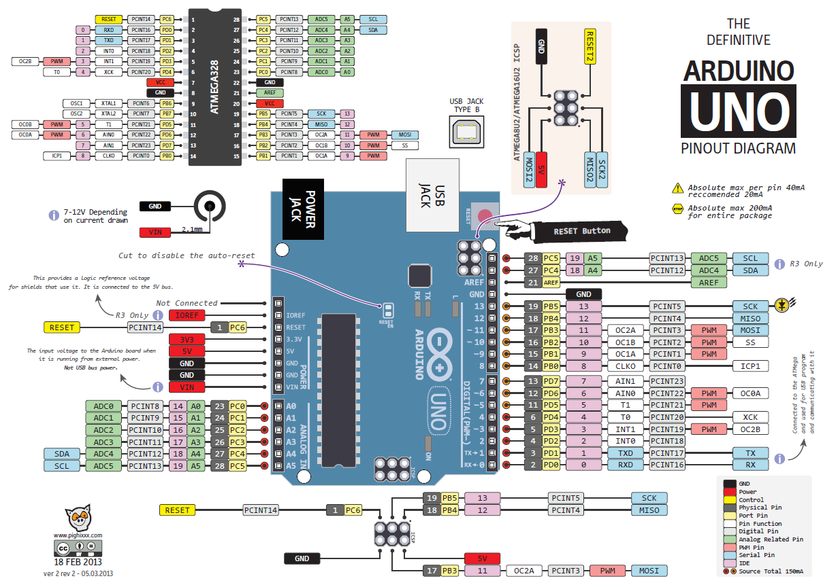

Slide 4
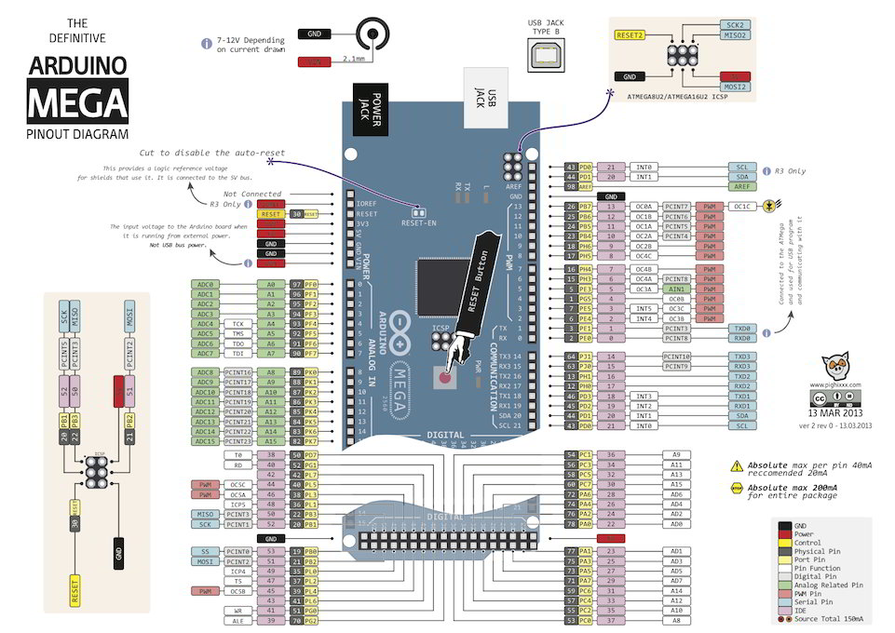

Slide 5
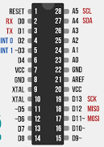

Typical device to PC interfacing
TX
RX
GND
USB-UART
converter
When a device is connected a ‘COM’ port is established at the PC

Slide 6
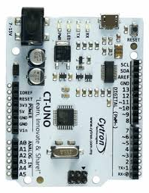
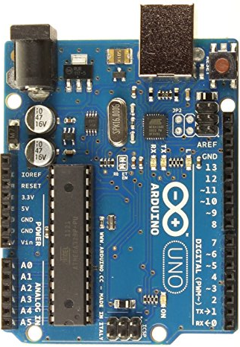
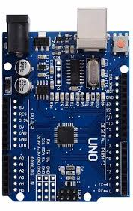
USB – UART Converter
FTDI - FT232RL
ATMEGA16U2
CH340G

Slide 7
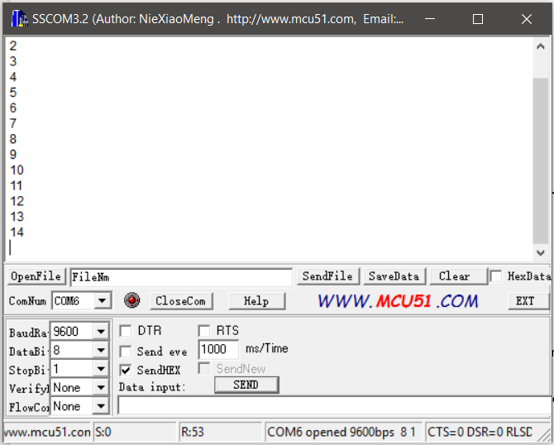
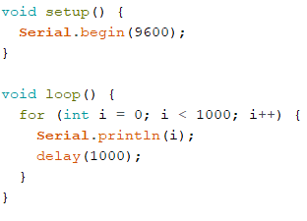
You can access these established ‘COM’ port using free software such as TeraTerm, SSCOM32, etc..

Slide 8
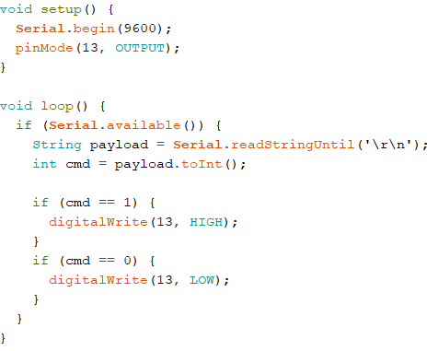
Send command from PC to turn On and Off an LED attached to the Arduino
Since the Arduino is programmed to listen to the UART port and turns on on-board LED on when it receives ‘1’ and turns off on-board LED when it receives ‘0’.
You can send command ‘1’ or ‘0’ using free software such as SSCOM32 or write Python script to talk to the Arduino
Task: Use Python script on Raspi to communicate with Arduino to turn On and Off on-board LED

Slide 9
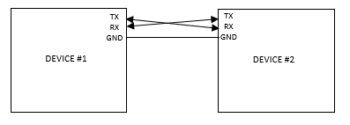
Typical device to Device (UART) – Device (UART) interfacing

Slide 10
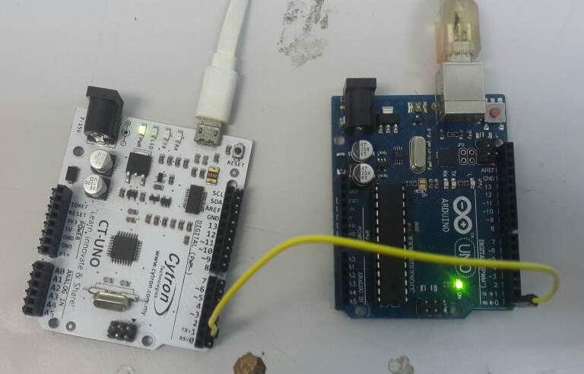
Simple device to Device (UART) – Device (UART) interfacing
Device #2
Device #1

Slide 11
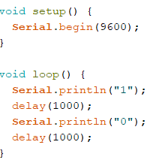
Simple device to Device (UART) – Device (UART) interfacing
Device #1
Device #2

Slide 12
Arduino SoftwareSerial Library
Since the Hardware UART chip is connected to 0 and 1 which also goes to the computer via USB connection often time we want to use this port for debugging purposes by displaying on the serial monitor.
SoftwareSerial library allows user to enable any digitial i/o pin to allow serial communication.
You can use this to allow UART communication to other devices
Task: Try now communicating with softwareserial UART instead of hardware UART

